Slide 1



TribeFlow Mining & Predicting User Trajectories
Flavio Figueiredo Bruno Ribeiro
Jussara M. Almeida Christos Faloutsos
Notes:
Institutions in order of appearance
Name the authors, where everyone is now

Slide 2
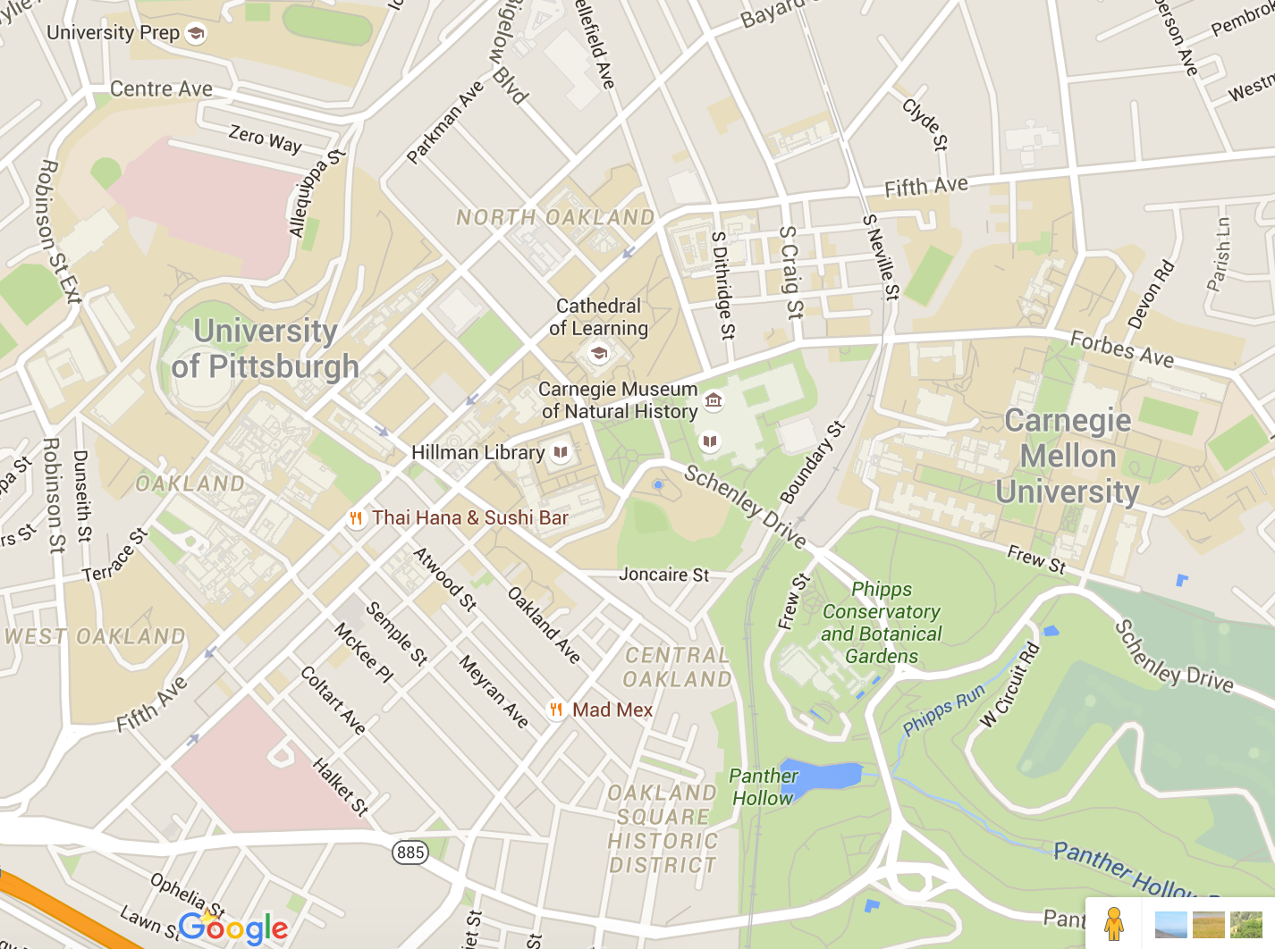
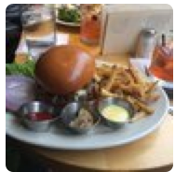
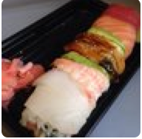


Example: Online Check-Ins
2
Notes:
- Public datasets: user, item, time. Anonymous

Slide 3

What Happens x What we See
L1
T₁
L2
Time
T₂
L1
T₃
L3
3
Notes:
Public datasets: user, item, time. Anonymous
Explain quicker. Focus on the important.

Slide 4


Different Behaviors Different Trajectories
1
2
3
1
4
1
5
6
1
1h
0.5h
3h
5h
1h
6h
Duration in Location
Notes:
Talk about time
Personalized quicker

Slide 5



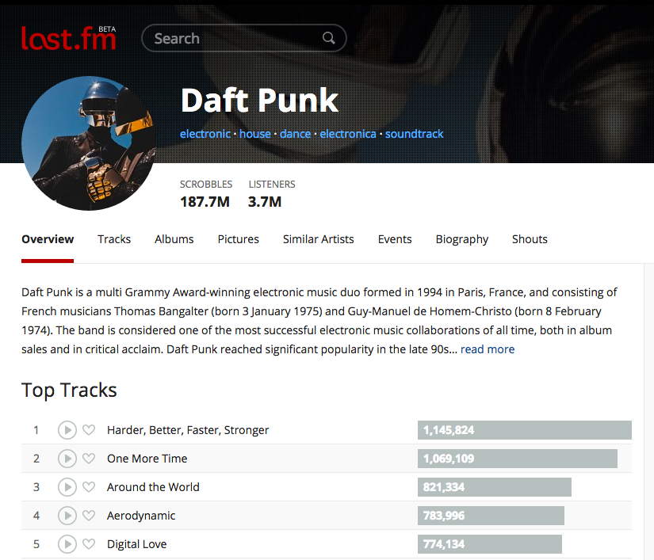
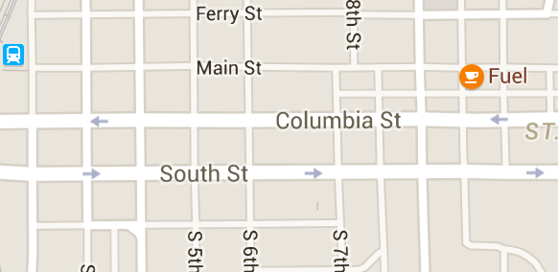
General Motivation
??
Predict where an agent will go next
??
??
5
Notes:
Can be used to predict
Music Recommendation
Similar Items Recommendation

Slide 6
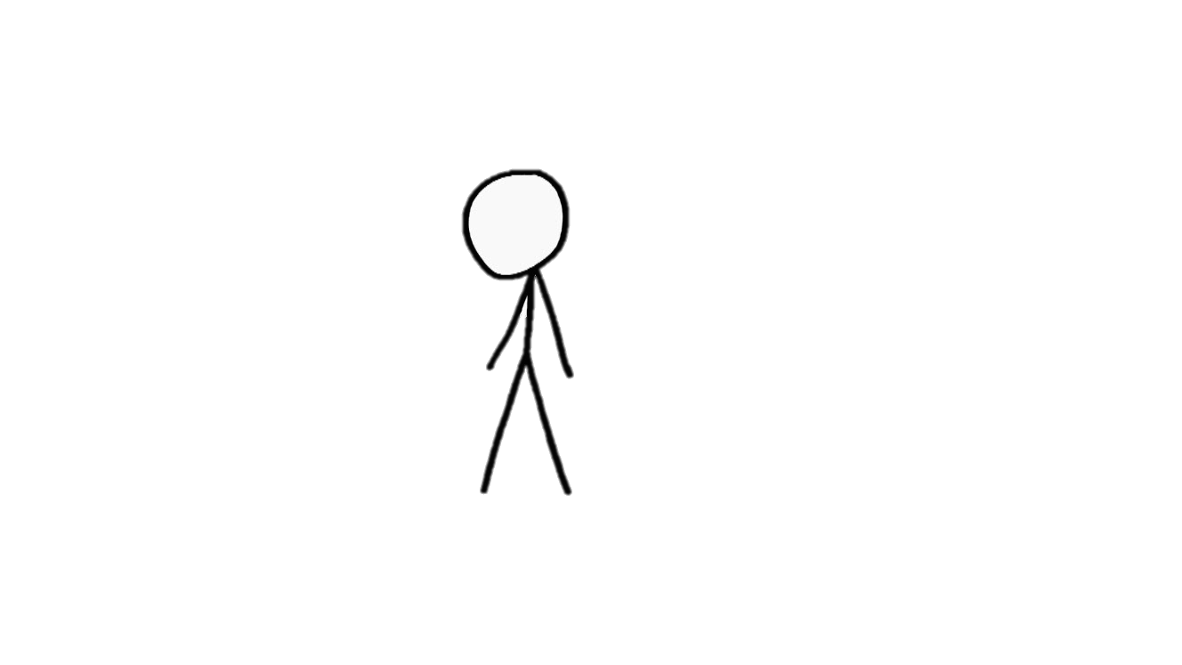
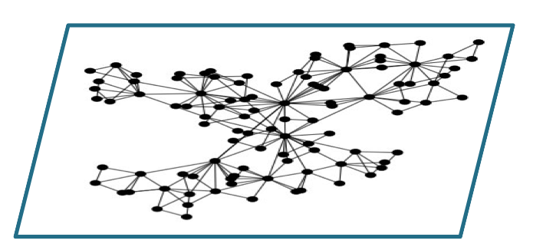

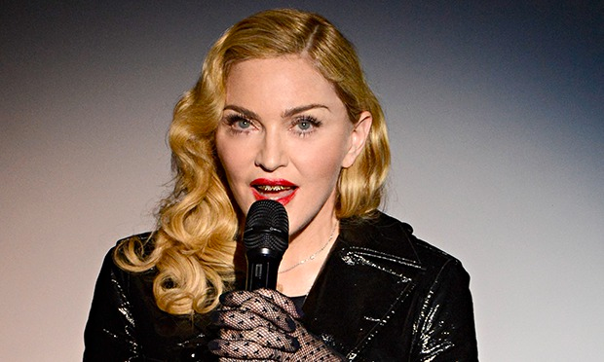

How we Navigate?
Notes:
- Inside the website

Slide 7

Navigational Constraints
Geographical Constraints
Check-in at Eiffel Tower followed by Statue of Liberty Probably not
Starbucks at JFK followed by McDonalds at Beijing Airport. Possible
Application Constraints (e.g., Links on the Application)

Slide 8
Simple Navigation Process (e.g., PageRank)
3
2
Visible Links
Random Walks w. Random Jumps to Random Nodes
5
4
1
6

Slide 9
Random Walk Transition Matrix
What if we don’t see the links?
Trajectories are all we see.
 | 1 | 2 | 3 | 4 | 5 | 6
1 | .025 | .025 | .025 | .875 | .025 | .025
2 | .45 | .025 | .025 | .45 | .025 | .025
3 | .025 | .875 | .025 | .025 | .025 | .025
4 | .025 | .025 | .025 | .025 | .45 | .45
5 | .025 | .025 | .875 | .025 | .025 | .025
6 | .166 | .166 | .166 | .166 | .166 | .166
3
2
5
1
2
3
4
1
6
1h
0.5h
And no self-loops: Modeling self-loops is separate problem.
See Figueiredo et al. PKDD2014, Benson et al. WWW 2016, …
P[Next| Previous]
Notes:
- Markov not markovian

Slide 10
Latent Random Walk Transition Matrices
“Pop Music”
 | 1 | 2 | 3 | 4 | 5 | 6
1 | .025 | .025 | .025 | .875 | .025 | .025
2 | .45 |  | .025 | .45 | .025 | .025
3 | .025 | .875 |  | .025 | .025 | .025
4 | .025 | .025 | .025 |  | .45 | .45
5 | .025 | .025 | .875 | .025 |  | .025
6 | .166 | .166 | .166 | .166 | .166 | .166
Latent Transition Matrices
Navigation constraints
Navigation preferences based on user types
We must learn:
Transition matrices from trajectory data
From multiple users
User preferences over matrices
“Bossa Nova”
 | 1 | 2 | 3 | 4 | 5 | 6
1 | .165 | .165 | .165 | .165 | .165 | .165
2 | .45 |  | .025 | .45 | .50 | .025
3 | .025 | .875 |  | .025 | .025 | .025
4 | .025 | .025 | .025 |  | .45 | .45
5 | .025 | .025 | .875 | .025 | . | .025
6 | .166 | .166 | .166 | .166 | .166
“Heavy Metal”
 | 1 | 2 | 3 | 4 | 5 | 6
1 | .165 | .165 | .165 | .165 | .165 | .165
2 | .165 |  | .165 | .165 | .165 | .165
3 | .165 | .165 |  | .165 | .165 | .165
4 | .025 | .025 | .025 |  | .45 | .45
5 | .025 | .025 | .025 | .475 |  | .45
6 | .025 | .025 | .025 | .475 | .45
Notes:
Evitar a palavra fallacy (in reality)
Preference for multiple users

Slide 11
TribeFlow’s Environments
Time between transitions
P[Env = Green | User = Jane]
 | 1 | 2 | 3 | 4 | 5 | 6
1 |  | .165 | .165 | .165 | .165 | .165
2 | .165 | .025 | .025 | .45 | .025 | .025
3 | .165 | .875 | .025 | .025 | .025 | .025
4 | .025 | .025 | .025 | .025 | .45 | .45
5 | .025 | .025 | .875 | .025 | .025 | .025
6 | .166 | .166 | .166 | .166 | .166 | .166
Time between transitions
 | 1 | 2 | 3 | 4 | 5 | 6
1 | . | .165 | .165 | .165 | .165 | .165
2 | .45 | .025 | .025 | .45 | .50 | .025
3 | .025 | .875 | .025 | .025 | .025 | .025
4 | .025 | .025 | .025 | .025 | .45 | .45
5 | .025 | .025 | .875 | .025 | .025 | .025
6 | .166 | .166 | .166 | .166 | .166 | .166
 | .45 | .35 | .1 | .1
 | .50 | .025 | .025 | .45
 | 1 | 2 | 3 | 4 | 5 | 6
1 |  | .025 | .025 | .875 | .025 | .025
2 | .45 | .025 | .025 | .45 | .025 | .025
3 | .025 | .875 | .025 | .025 | .025 | .025
4 | .025 | .025 | .025 | .025 | .45 | .45
5 | .025 | .025 | .875 | .025 | .025 | .025
6 | .166 | .166 | .166 | .166 | .166 | .166
 | 1 | 2 | 3 | 4 | 5 | 6
1 |  | .35 | .165 | .165 | .165 | .165
2 | .165 |  | .165 | .165 | .165 | .165
3 | .165 | .35 |  | ..165 | .165 | .165
4 | .025 | .025 | .025 |  | .45 | .45
5 | .025 | .025 | .025 | .025 |  | .45
6 | .025 | .025 | .025 | .025 | .45 | .45
Time between transitions
Transition & Time
P[Node = 3 | Node = 5, Env = Green] x P[inter-event time > T | Env = Green]
Time between transitions

Slide 12
Problem Definition
5
6
1
Input:
Large dataset of user trajectories from thousands of users
Output:
Set of latent transition matrices
Set of user preferences over these matrices
That is:
Interpretable and accurate Alice will listen to ‘4’ next!
1
4
1
1
2
3

Slide 13
Defining the Model

Slide 14
How many Transition Matrices?
We Use a Bayesian Nonparametric Model
Learned from the data
Dirichlet process prior over user preference vector (rows)
 |  |  |  | …
 | .45 | .35 | .1 | …
 | .50 | .025 | .025 | ...
 | .3 | .3 | .3 | …
Notes:
- Don’t mention topic models

Slide 15
Decomposing User Trajectories
 | .3 | .4 | .25 | .05
Unlikely in Red Environment (Jump)
1
2
3
6
5
7
10
12
2min
1min
2 min
5min
1min
2min
24 hours
Unlikely in Green Environment (Jump)

Slide 16
Dealing With Sparseness
Sparseness Issue
Millions of items (e.g., web pages / artists)
~10¹² bigrams (Source, Destination) – Last.FM artists
Only ~10⁸ (Source, Destination) pairs largest dataset [LastFM-Groups]
Thus, Random Walk transition probabilities over vertices rather than edges (without self-loops)

Slide 17
Learning the Model

Slide 18
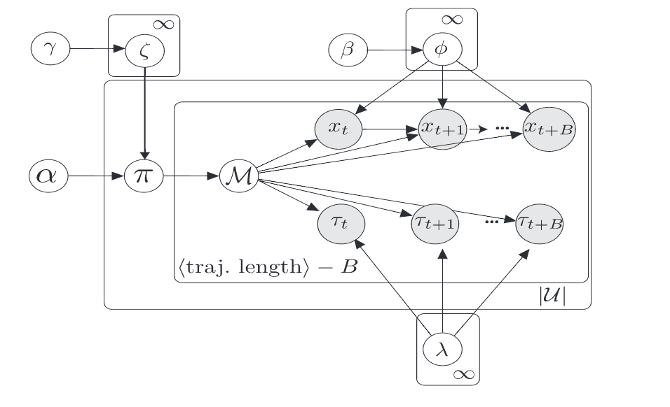
TribeFlow’s Generative Model
Generative model variables:
Environments:
Transition Matrix
Simplify inference by breaking up sequence into renewal times of length B
Inter-event time distribution
Latent user preferences over environments
Notes:
- Tirar o “very nice”

Slide 19
TribeFlow Inference
Gibbs sampling
Item Transitions
User Preferences
Inter-event times
Merge and Split Moves
To infer Dirichlet Process
Fully Distributed
Based on AsyncLDA: Asuncion, 2009, NIPS

Slide 20
Results

Slide 21
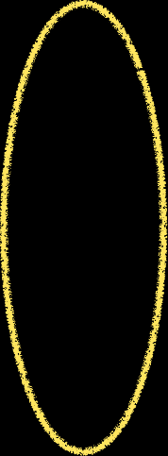
TribeFlow at Work
Years of data
70% train + validation
30% test
time

Slide 22
Prior Work for Comparison
Latent Markov Embedding (LME), Chen et al., KDD, 2012
Multi-core Latent Markov Embedding, Chen et al., KDD 2013
PRLME, Personalized Ranking LME, Feng et al., IJCAI 2015
Factorizing Machines (FPMC), Rendle et al. WWW 2010
Progression Stages (Stages), Yang et al., WWW 2014
Gravity Model (Gravity)
Commonly used by various authors to measure flow between locations Silva et al., 2006, García-Galivanes et al., CSCW 2014, Smith et al., CSCW 2013
Common issues (except Stages & Gravity):
Don’t scale
Not personalized
No probabilistic interpretation
Notes:
- Find a place for this slide

Slide 23
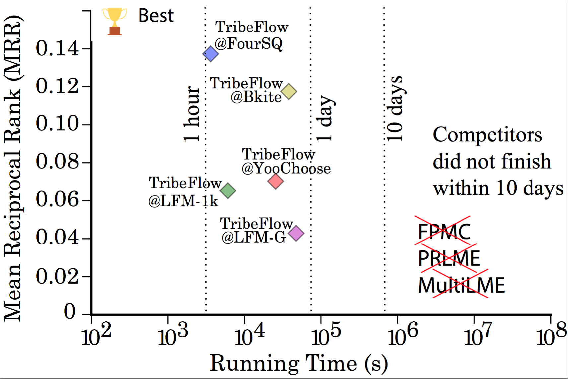
Predicting Where Users Go Next
More Accurate
20 cores
one node
Faster

Slide 24
Using Data Subsamples
20 cores
one node
Always faster & more accurate
Always faster and more
accurate

Slide 25
Further Comparisons
TribeFlow vs. MultiLME – Scalability (Chen et al, 2013)
TribeFlow is 413x Faster
At least 12% higher Predictive Likelihood
TribeFlow vs. Stages (Yang et al, 2014)
TribeFlow at least 40% higher MRR (Mean Reciprocal Ranking)
In the datasets that we were able to execute Stages
TribeFlow vs. Gravity Model (Silva et al, 2006)
Number of users that go from A to B
Gravity Models are Fast (Poisson Regression)
However, TribeFlow was 800% more accurate in MAE
Notes:
MultiLME is slow because it does not focus on rankings
Don’t say it did not execute

Slide 26
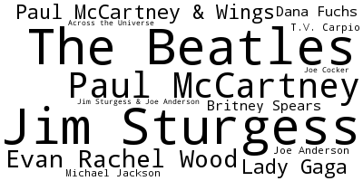
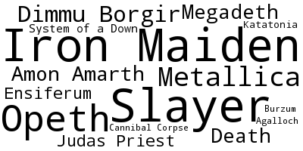
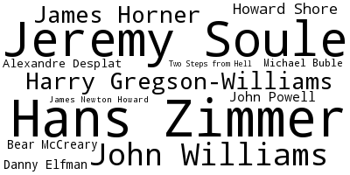
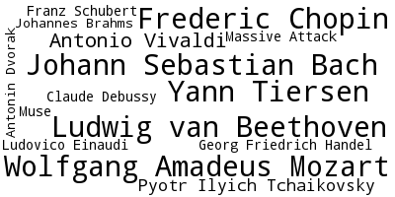
Sense Making: Music Streaming Data
Data crawled using Pop artists as seeds.
Natural bias towards Pop music
“Metal”
“Beatles”
“Classic”
“Soudtracks”
Notes:
Explain the dataset
Explain the figure slowly
Size
Steady state of the random walk
Visual cues towards to the environments

Slide 27
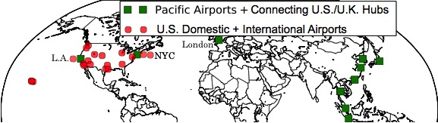

Sense Making: FourSquare Data
Why these environments?
These are airports
TribeFlow is learning the constraints
No use of GPS information
Notes:
Airports violate geographical constraints but creates new ones.

Slide 28
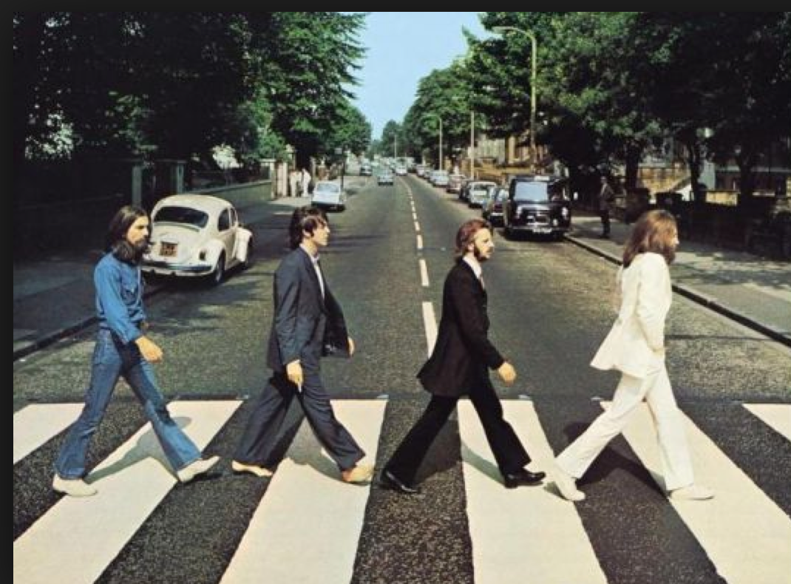
Users are not Synchronized
“Everybody” eventually goes through a “Beatles” phase

Slide 29
TribeFlow x Temporal Tensors
K x t
C
time
I x J x K
X
I x r
K x s
A
G
B
=
users
r x s x t
products
If users are not synchronized:
Notes:
- Simulated data

Slide 30
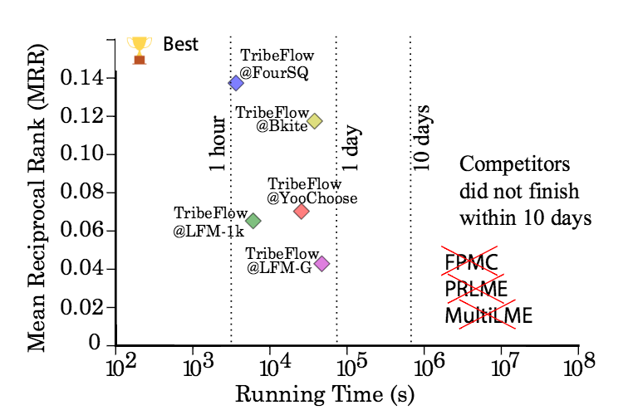
Conclusions
TribeFlow
Predicts & mines user trajectories
Fast & scalable
Accurate & interpretable
Thank You!
http://flaviovdf.github.io/tribeflow
Notes:
- Model, or matrices, or crownjewel

